Slide 1
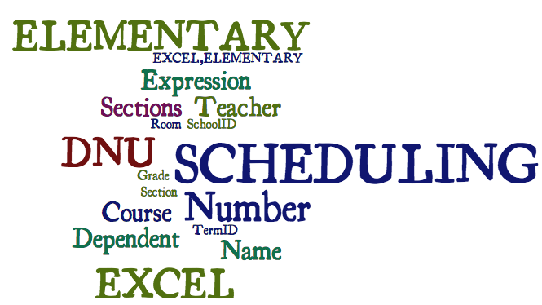
Elementary Scheduling w/Excel: Admin Choice for Specials
Bob Cornacchioli DERO Technical Services
bcornacchioli@gmail.com
get2bobc@gmail.com
www.derotechnical.com

Slide 2
Agenda/Participants will be engaged in:
Courses – Sections = WHAT
Teacher Numbers = WHO
Rooms = WHERE
Days – EXPRESSIONS – Periods & Term ID = WHEN
Dependent Sections
EOY – Mass Enroll
www.derotechnical.com for more resources

Slide 3
CEO - DERO Technical Services Evangelist/Process Lead- Level Data Marketing/ - ParkBench Software
Trainer
Director of Technology and Media Services Shrewsbury Public Schools (16 yrs) PowerSchool Administrator (6 yrs)
Alpha/Beta Team for and PTP
Bob Cornacchioli

Slide 4
Who should schedule Your Elementary School?
Who knows the teachers best?
Who knows the rooms best?
Who knows about the shared staff?
BUILDING PRINCIPAL &
BUILDING SECRETARY/ADMIN ASST.

Slide 5
Husband, Father and Grampa
On Mother’s Day we found out about #4 – Nov 20th
Family First – Balance between work & living!!

Slide 6
What do you have now?
DRAW A LINE IN THE SAND
What format?

Slide 7
Or this?

Slide 8
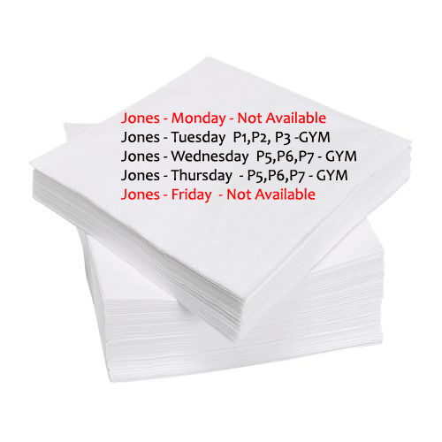
Never this I hope – I did!
Is it worth learning a new method?

Slide 9
Thought I would send you an UPDATE
3 years later I thought I would let you know I am still using the tool you provided to me to successfully and quickly setup my school for the new year. Thanks again Bob!
Every time I use this spread sheet of yours to upload my elementary Master Schedule it just makes my freaking day!
David Moon,
Technology Director,
Sultan School District,
Sultan, WA

Slide 10
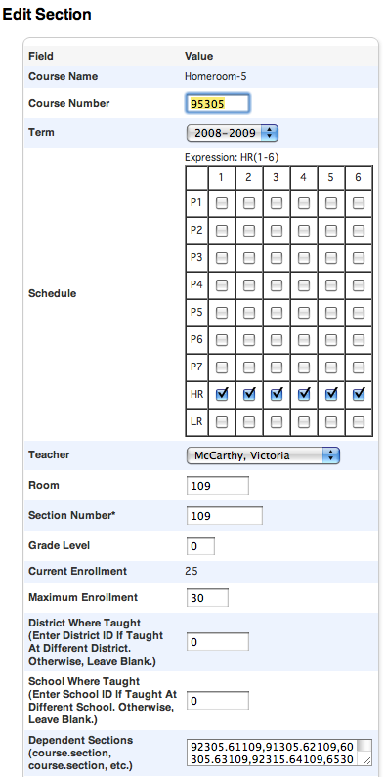
Convert it to this!
Course Name
Course Number
Term Length
Expression- When does it meet?
HR(1-6) would place a √ for each day
Teacher
Room – Where does it meet?
Grade Level – N/A
Section Number- VIP!!! Plenty of ideas here!!
Max Enrollment
Dependent Sections- If enrolled in this class students would also get these courses
WHAT
WHEN
WHO
WHERE

Slide 11
New Feature – Co Teaching (Not Just for High School Anymore! )
Different Roles provides non Lead Teachers
various levels of access

Slide 12
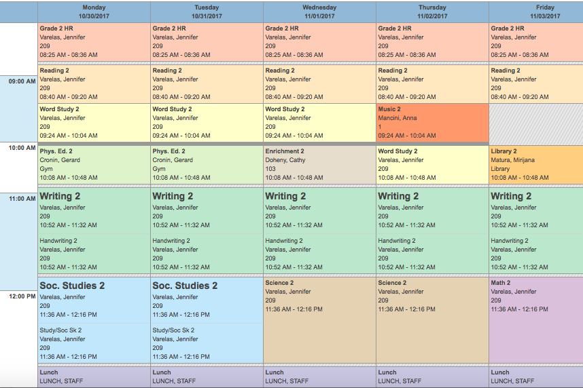
Bell Schedule View

Slide 13
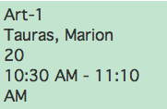
Dependent Sections Gray means w/HR Teacher
PS NEEDS:
WHAT
WHO
WHERE
WHEN
P
E
R
I
O
D
S
3(C)
3(E)
7(A)
8(B), 7(D)

Slide 14
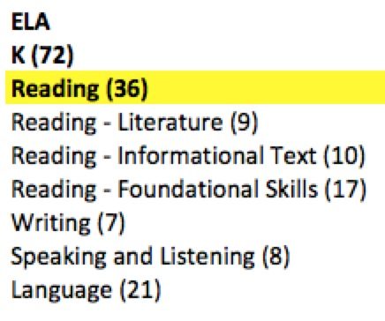
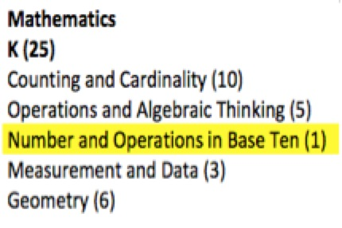
Should Common Core Standards Impact Scheduling?
How many courses are you
planning to use for
English Language Arts? Reading – Writing Speaking & Listening - Language

Slide 15
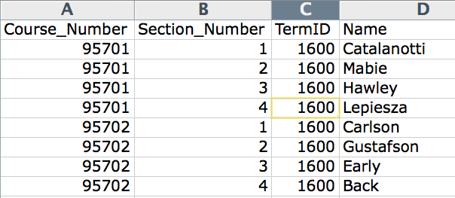
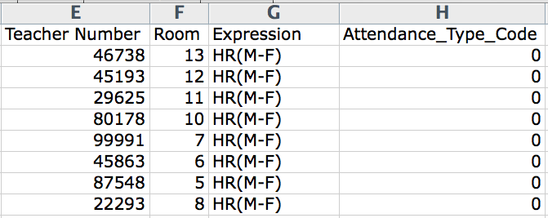
WHERE
WHEN
WHAT
WHO
`
Scheduling Spreadsheet

Slide 16
Term ID
Term ID = Scheduling Year 2006= 1600, 2009=1900, 2010=2000
What if a course last less than a full year, what would the term ID be?

Slide 17
Term ID’s for Less than Full Year Courses!
Full Year Course = 2300
T1 =2301, T2=2302, T3=2303
C1=2304, C2=2305, C3=2306, C4=2307, C5=2308, C6=2309
This year is?
Next year will be?

Slide 18
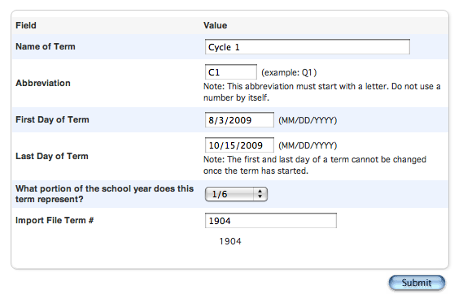
If you are importing – double √√√
Your numbers have to match
Full Year Course = 2300
T1 =2301, T2=2302, T3=2303
C1=2304, C2=2305, C3=2306, C4=2307, C5=2308, C6=2309

Slide 19
Don’t want to start from scratch!
[5]lastfirst
[5]title
[5]teachernumber
[5]status
[5]last_name
[5]first_name
SchoolID
[2]course_name
Course_Number
Dependent_Secs
Expression
^(*class_expression data="abbr" format="expression")
Grade_Level
Section_Number
Team
TermID
Attendance_Type_Code
Att_Mode_Code
Room
Got DDE Experience?
Then Export from the Sections (3) table
Select from this school only
Filter Term ID >= 2500 (for this year)
RED - export but DNU
BLUE - update for next year
ORANGE – rename to Expression to reimport
http://www.derotechnical.com/SCHEDULING/Scheduling.html

Slide 20
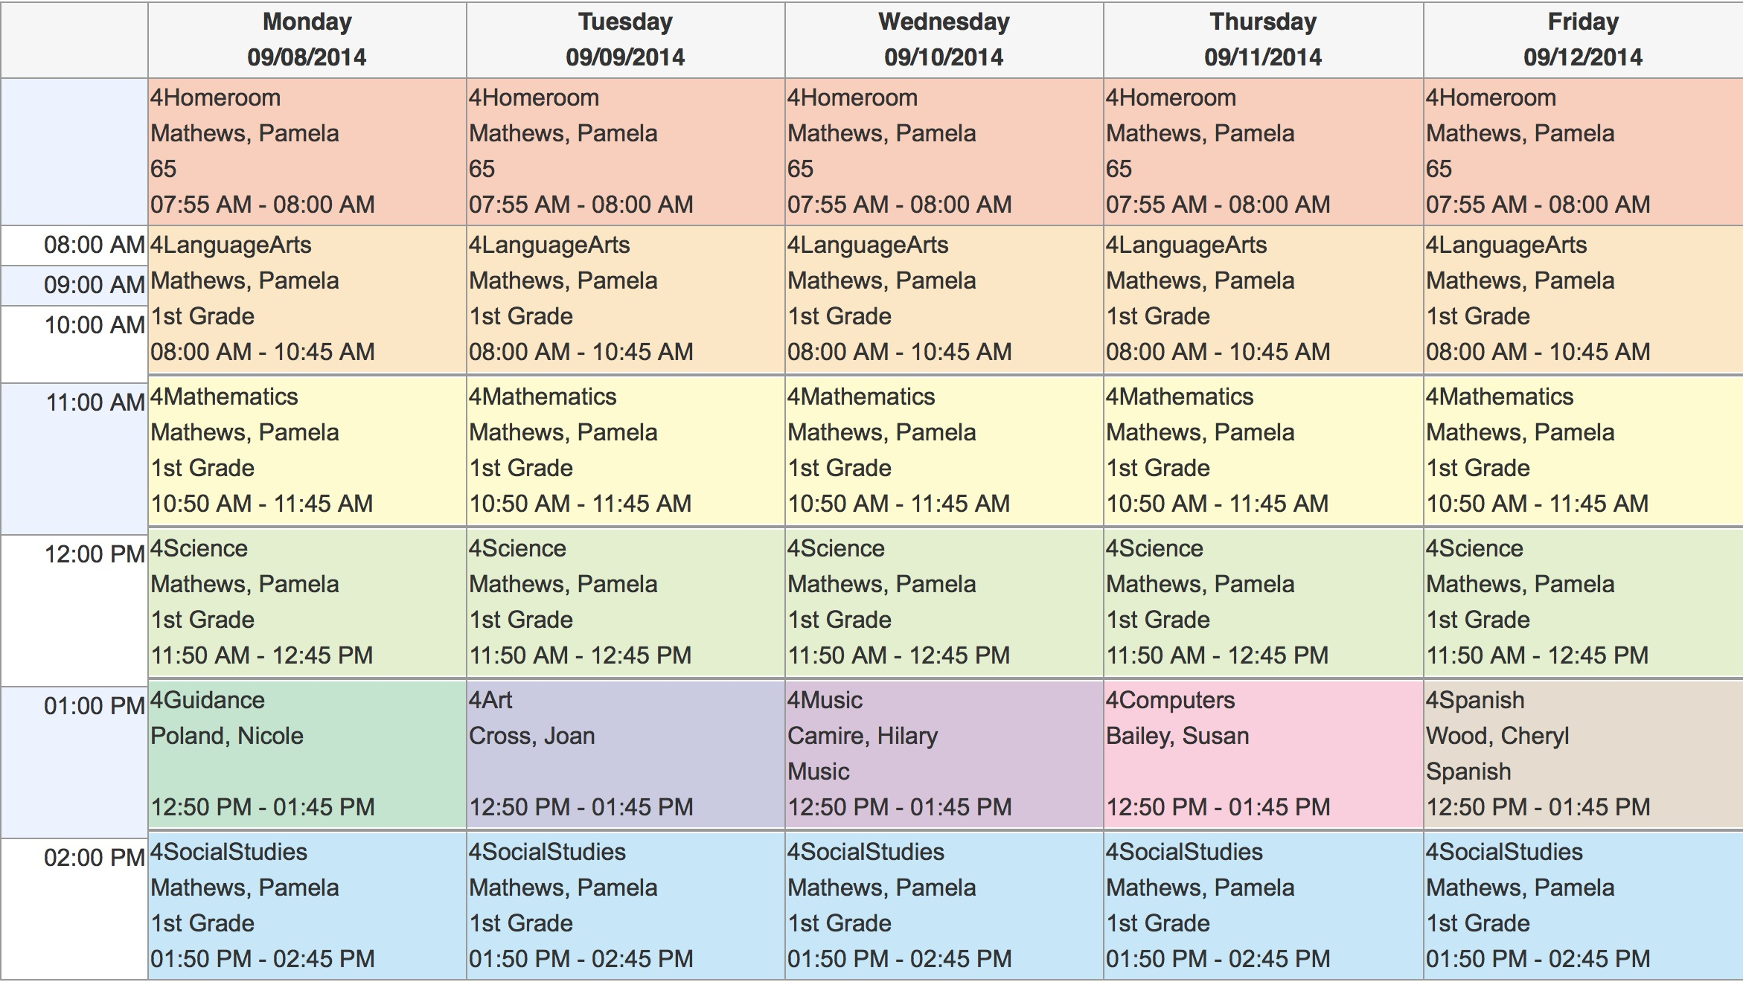
CHANGE AND RENAME Column L to Expression.
Do NOT Reimport Column K

Slide 21
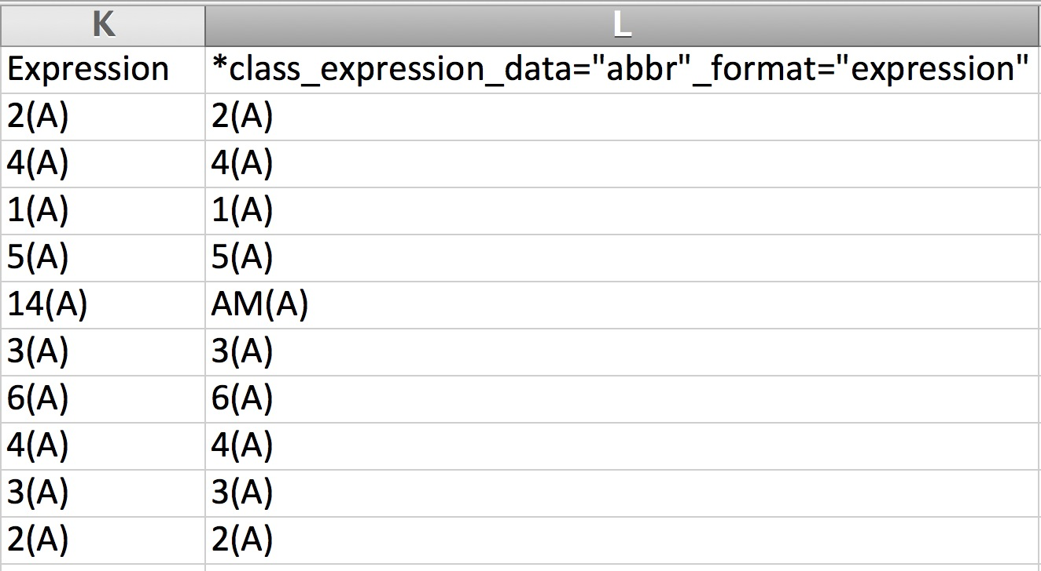
SIMPLE SCHEDULE LESS TWEAKING
RENAME Column L to Expression.
Do NOT Reimport Column K

Slide 22
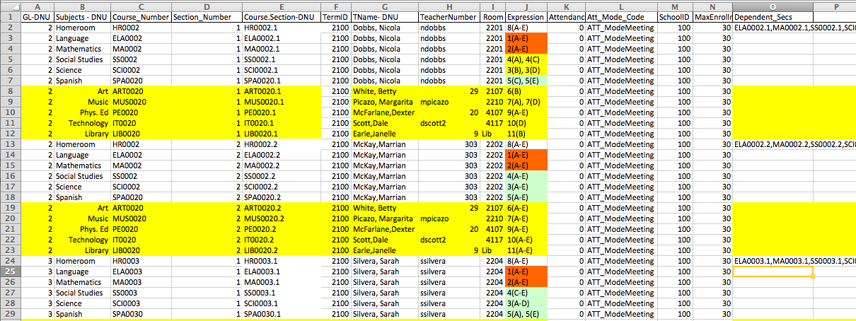
Excel Import File Must Be Converted
WHEN
WHAT
DNU- DO NOT IMPORT
Visual Clues
WHO
WHERE
Dependent Sections REQUIRES course.section,course.section,course.section
You can manually enter them OR….

Slide 23
Excellent with Excel?
Course.Section=CONCATENATE(C3,".",D3)
Dependency=course.section,course.section etc
=CONCATENATE(E4,",",E5,",",E6,",",E7,",",E8,",",E9,",",E10,",",E11,",",E12)
http://www.derotechnical.com/SCHEDULING/Scheduling.html
Karma Chameleon
Karma Karma Karma Karma Karma Chameleon You come and go You come and go

Slide 24
Depend Sections – depend_secs
Dependency=course.section,course.section, etc

Slide 25
WHAT
WHEN
WHO
WHERE
WHEN
NORMAL ELEMENTARY SCHEDULE....
HR Teacher appears on the spreadsheet 5 times - HR, ELA, MA, SS, SCI
Below list all the special subjects that his or her students take with other teachers
Once one HR teacher and his/her core subjects and specials are listed, copy/paste/change for teacher #2 for that same grade level. Repeat until all HR teachers for that grade level are complete

Slide 26
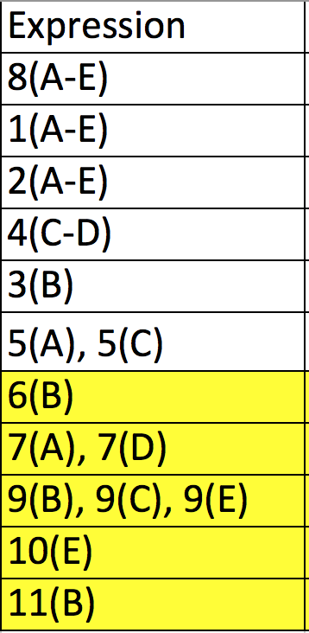
Expressions Period(Days) PRINT THIS PAGE
Days Monday = A
Tuesday = B
Wednesday = C
Thursday = D
Friday = E
Periods
1
2
3
4
5
6
7
8
9
10
11
Rules for Expressions
Contiguous Days use a DASH
(A-E) (A-C) (A-B)
Single Meeting Date
Period(Day)
Multiple meetings per week
Non-contiguous
Expression, SPACE Expression
5(A), 5(C)
9(B), 9(C), 9(E) or
9(B-C), 9(E)
Bell Schedule sets the time of these periods. If you need more periods that is done under Years and Terms

Slide 28
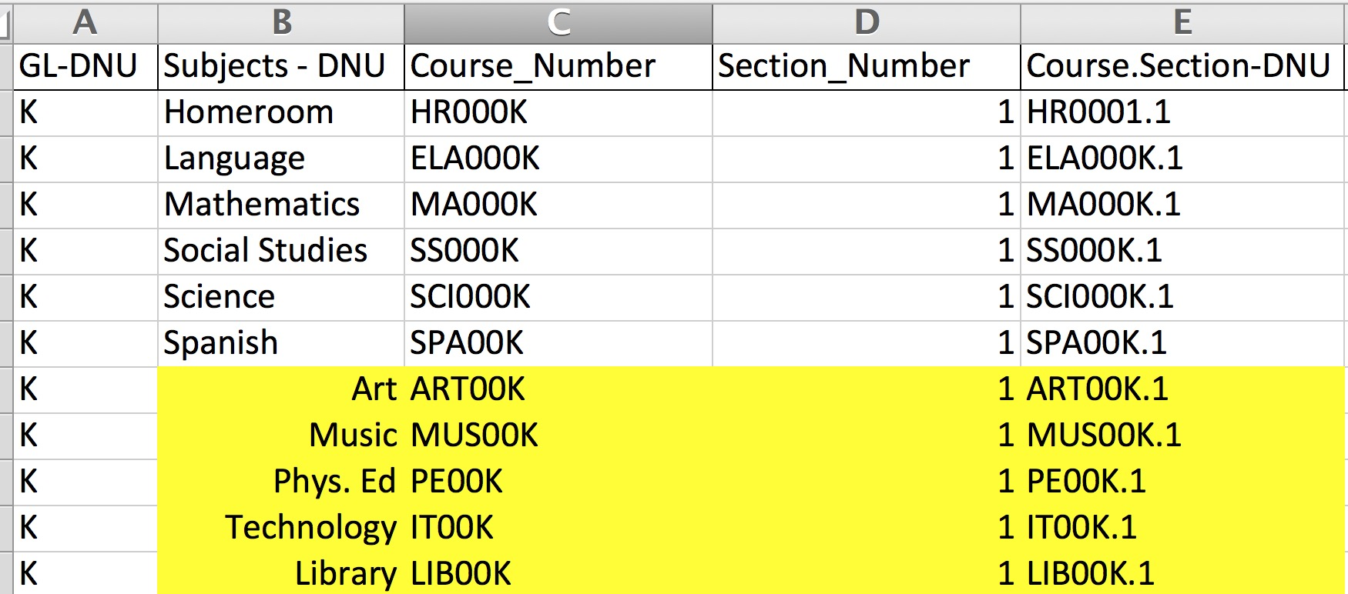
CLOSER LOOK AT THE COLUMNS This is one teacher’s schedule

Slide 29
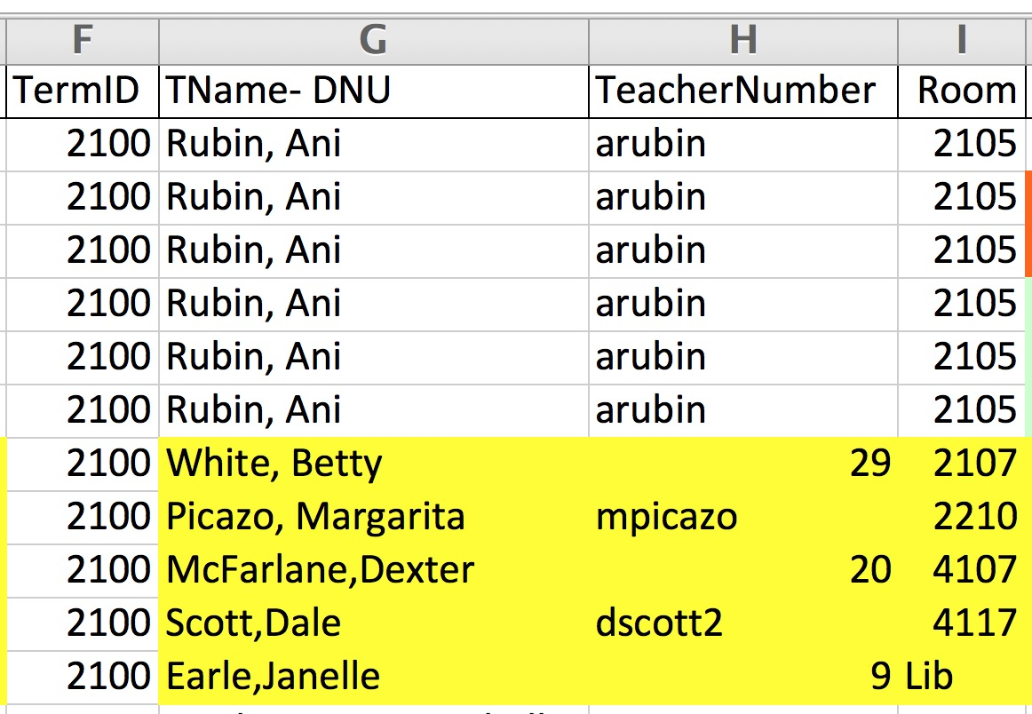
CLOSER LOOK AT THE COLUMNS

Slide 30
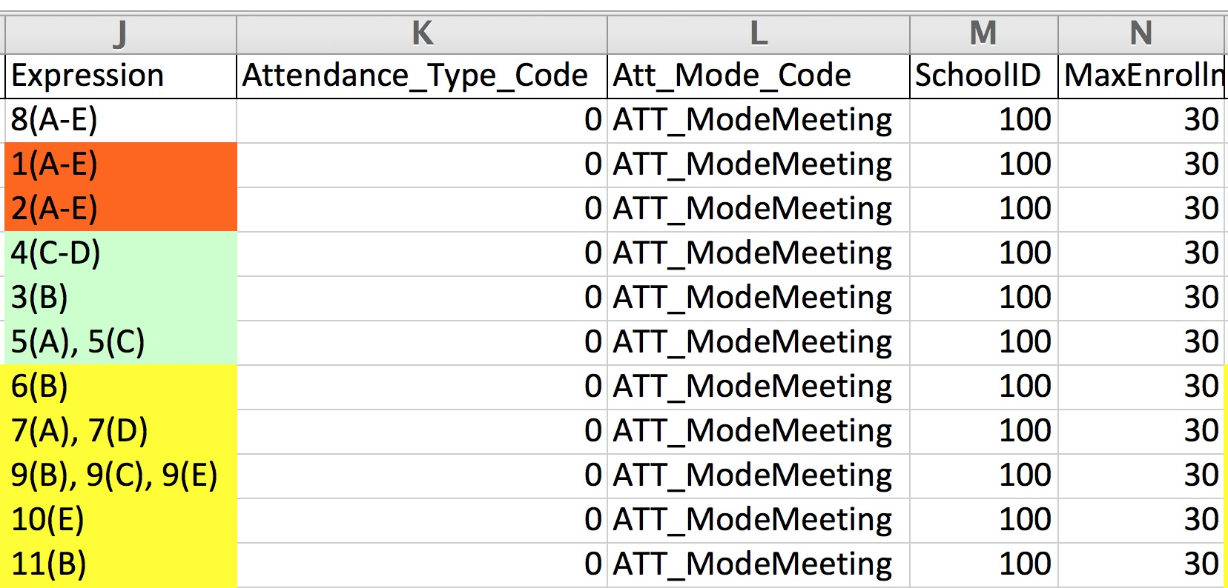
CLOSER LOOK AT THE COLUMNS

Slide 31
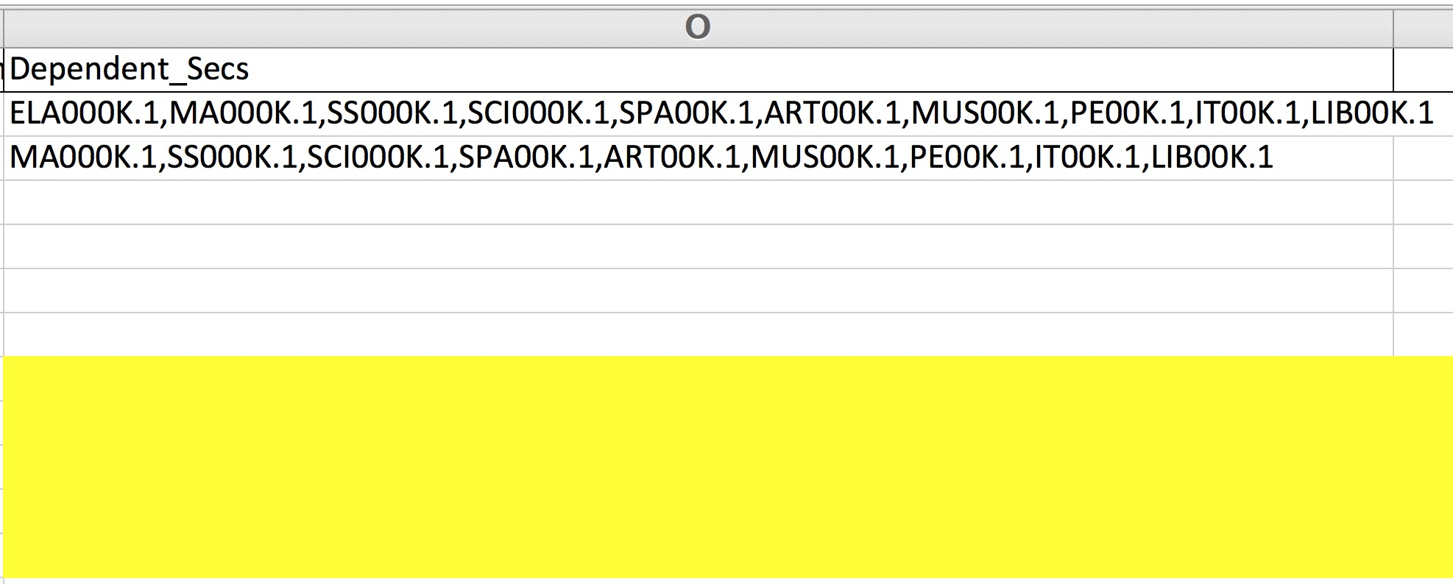
CLOSER LOOK AT THE COLUMNS

Slide 32
Dependent Section Options
HR >> ELA, MA, SCI, SS and SPECIALS if the students travel to ART, MUSIC, PE, HEALTH etc as a HR Group
If students go to SPECIALS as a new group other than HR but stay together as a group in these elective subjects then…
PE>> ART, MUSIC, HEALTH, LIBRARY
( upper elementary & MS Schools)

Slide 33
Best Practices – READY.txt

Slide 34
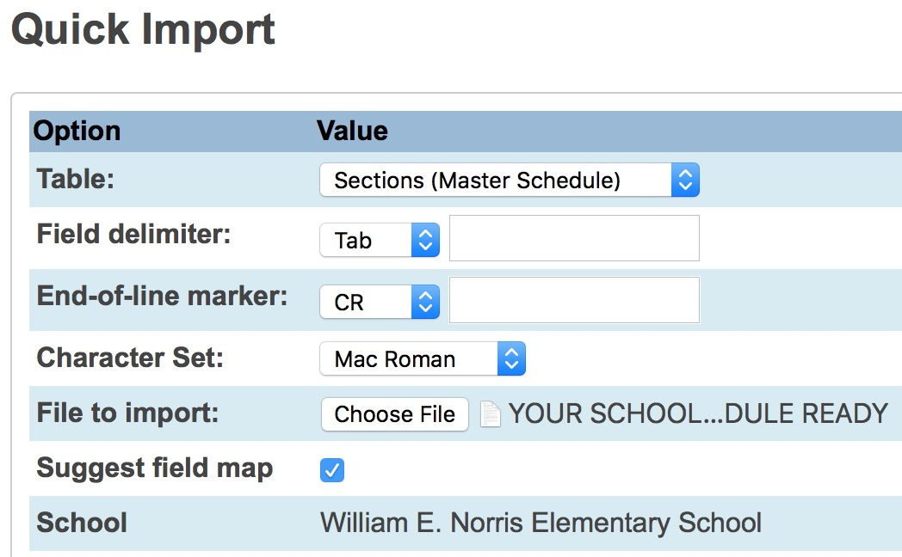
Importing Schedule into PowerSchool
Convert XLS to TEXT File (READY)
Special Functions
Importing and Exporting
Quick Import
Table- Sections (Master Schedule)
Find TXT file READY ( converted XLS file )
Match column names to those in PS

Slide 35
Import into the Sections (Master Schedule)
BUT WAIT!!!
Never REMOVE √

Slide 36
99% Import to the LIVE SIDE
In 12 years, one person wanted to import into the Scheduler Side
Double check how the Scheduler side wants EXPRESSION to list.. Could be different
Both Attendance columns AREN’T NEEDED
As this data has been set in your Build preferences
ADD BUILD ID to spreadsheet

Slide 37
Suggested Field Map
√
Removes Column Headers that were used in Excel
Name is not used in PS, but I use it as a visual clue.
Do you know your teacher numbers?
ANY File Headers in EXCEL on LEFT with DNU will not match
PS Fields on Right.

Slide 38
After Import – RED is BAD!
After importing PowerSchool displays a page with your results.
RED is an error and it “clearly” tells you ( HA!) what these mean. Go slow it’s doable
Typical Errors:
Bad teacher numbers
Expression is wrong
Term ID is wrong/not set

Slide 39
Mass Enroll Function
AFTER EOY AFTER EOY AFTER EOY
Course.Section this identifies your teachers/rooms and periods
Enrollment Date – NORMALLY first day of school .
This date is always the date of your action, you must change it!

Slide 40
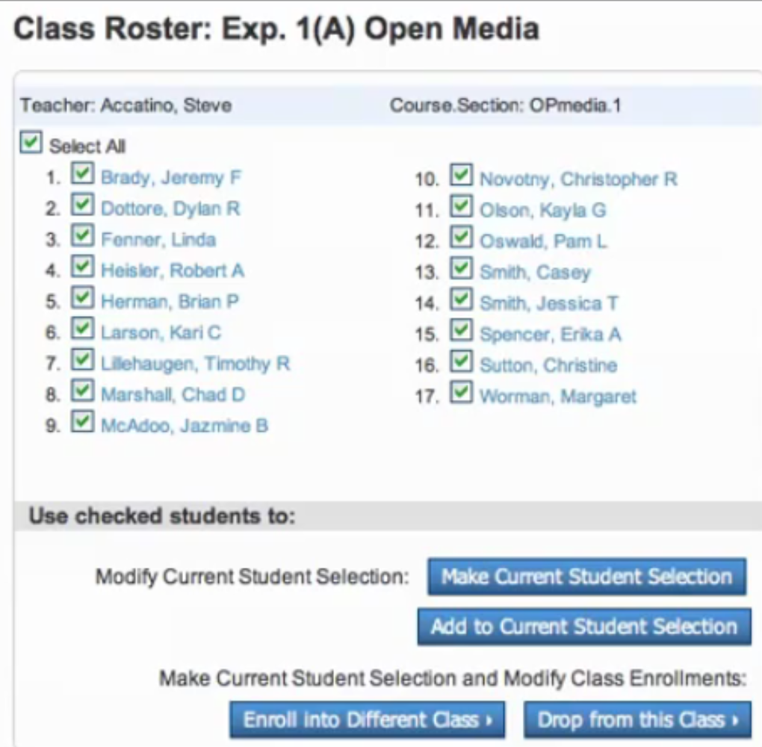

Slide 41
Q & A
ANY AND ALL DERO RESOURCES ARE AVAILABLE
TO DOWNLOAD, TWEAK and USE FOR YOUR DISTRICT!
Bob Cornacchioli DERO Technical Services
bcornacchioli@gmail.com
get2bobc@gmail.com
www.derotechnical.com

Slide 42
Visual PST
evScheduler
If you would like a demo
license – please email me
get2bobc@gmail.com
FREE DEMO until Nov 30th
$450 per year per district

Slide 43
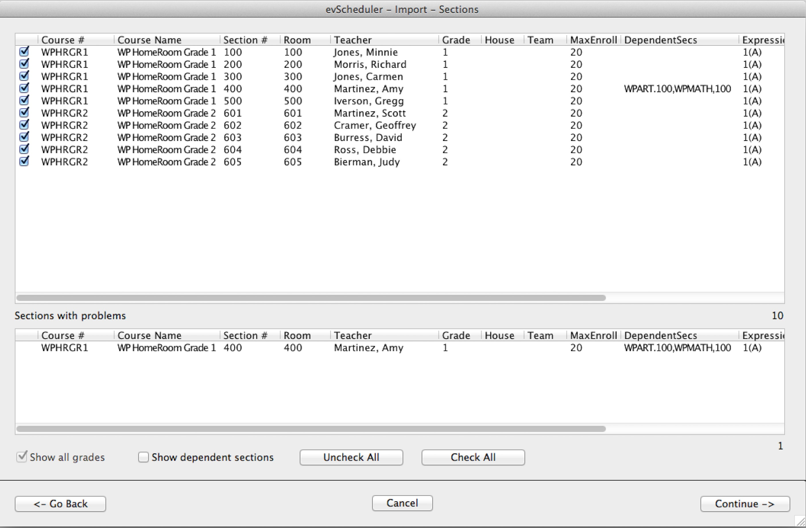
evScheduler
ODBC/ PowerSchool (Pulls data from Live or Schedule side)
SET-UP QUESTIONS – what grades, what classes, teachers, dependent sections etc.

Slide 44
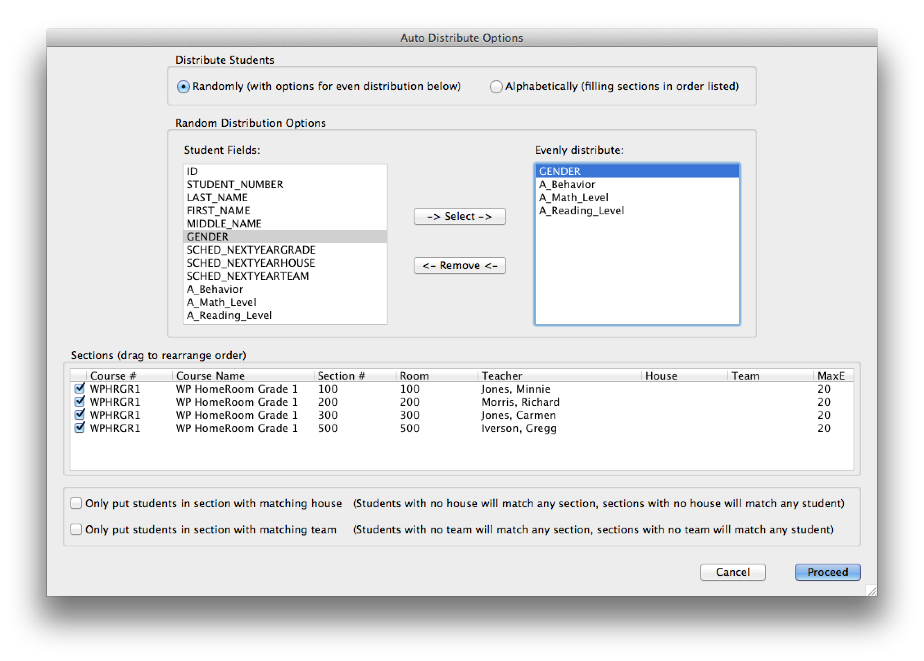
evScheduler

Slide 45
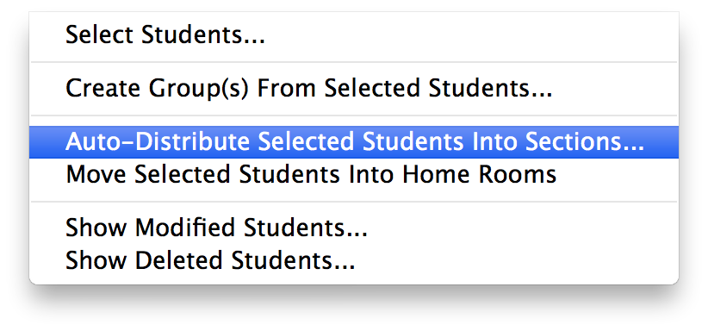
evScheduler
ODBC/ PowerSchool
(Pulls data from Live or Schedule side)

Slide 46
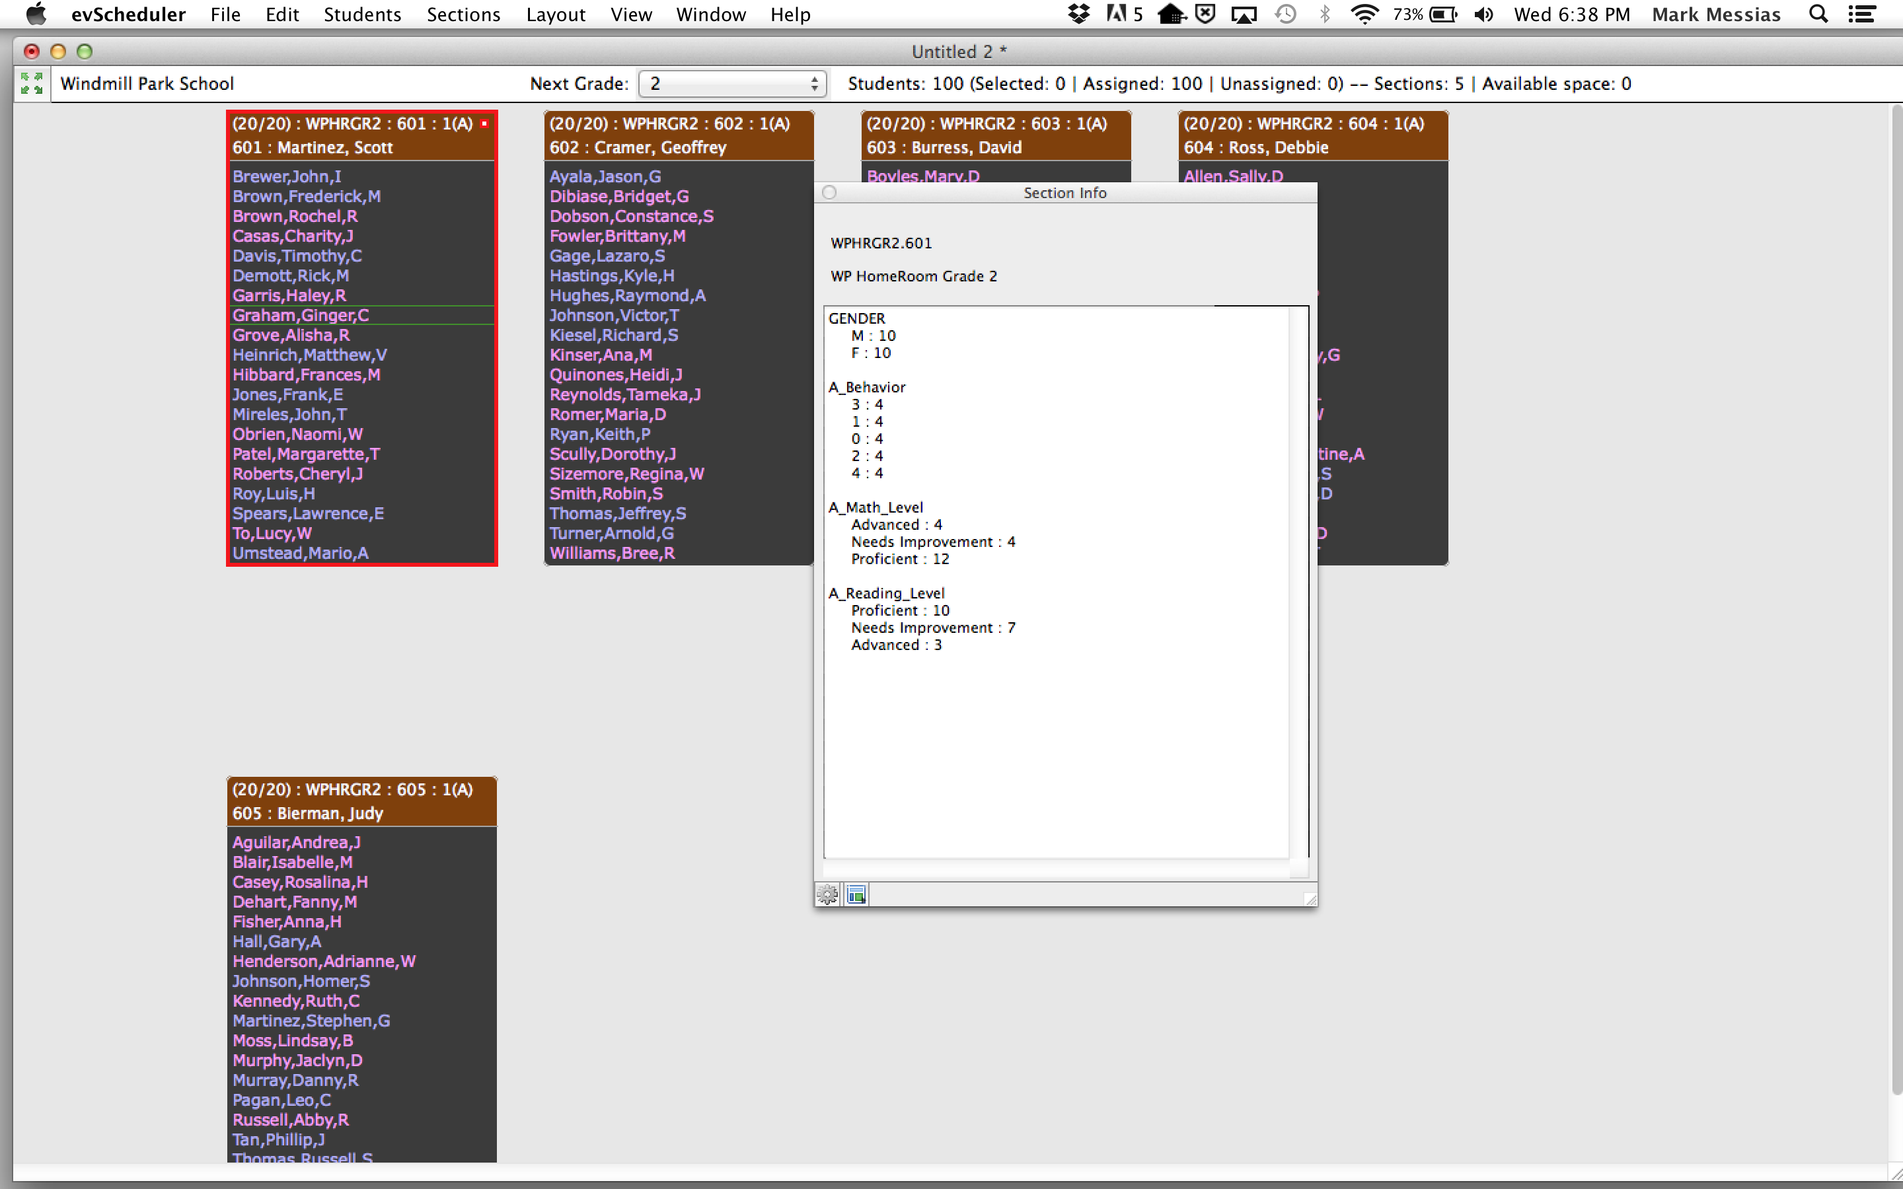
evScheduler

Slide 47
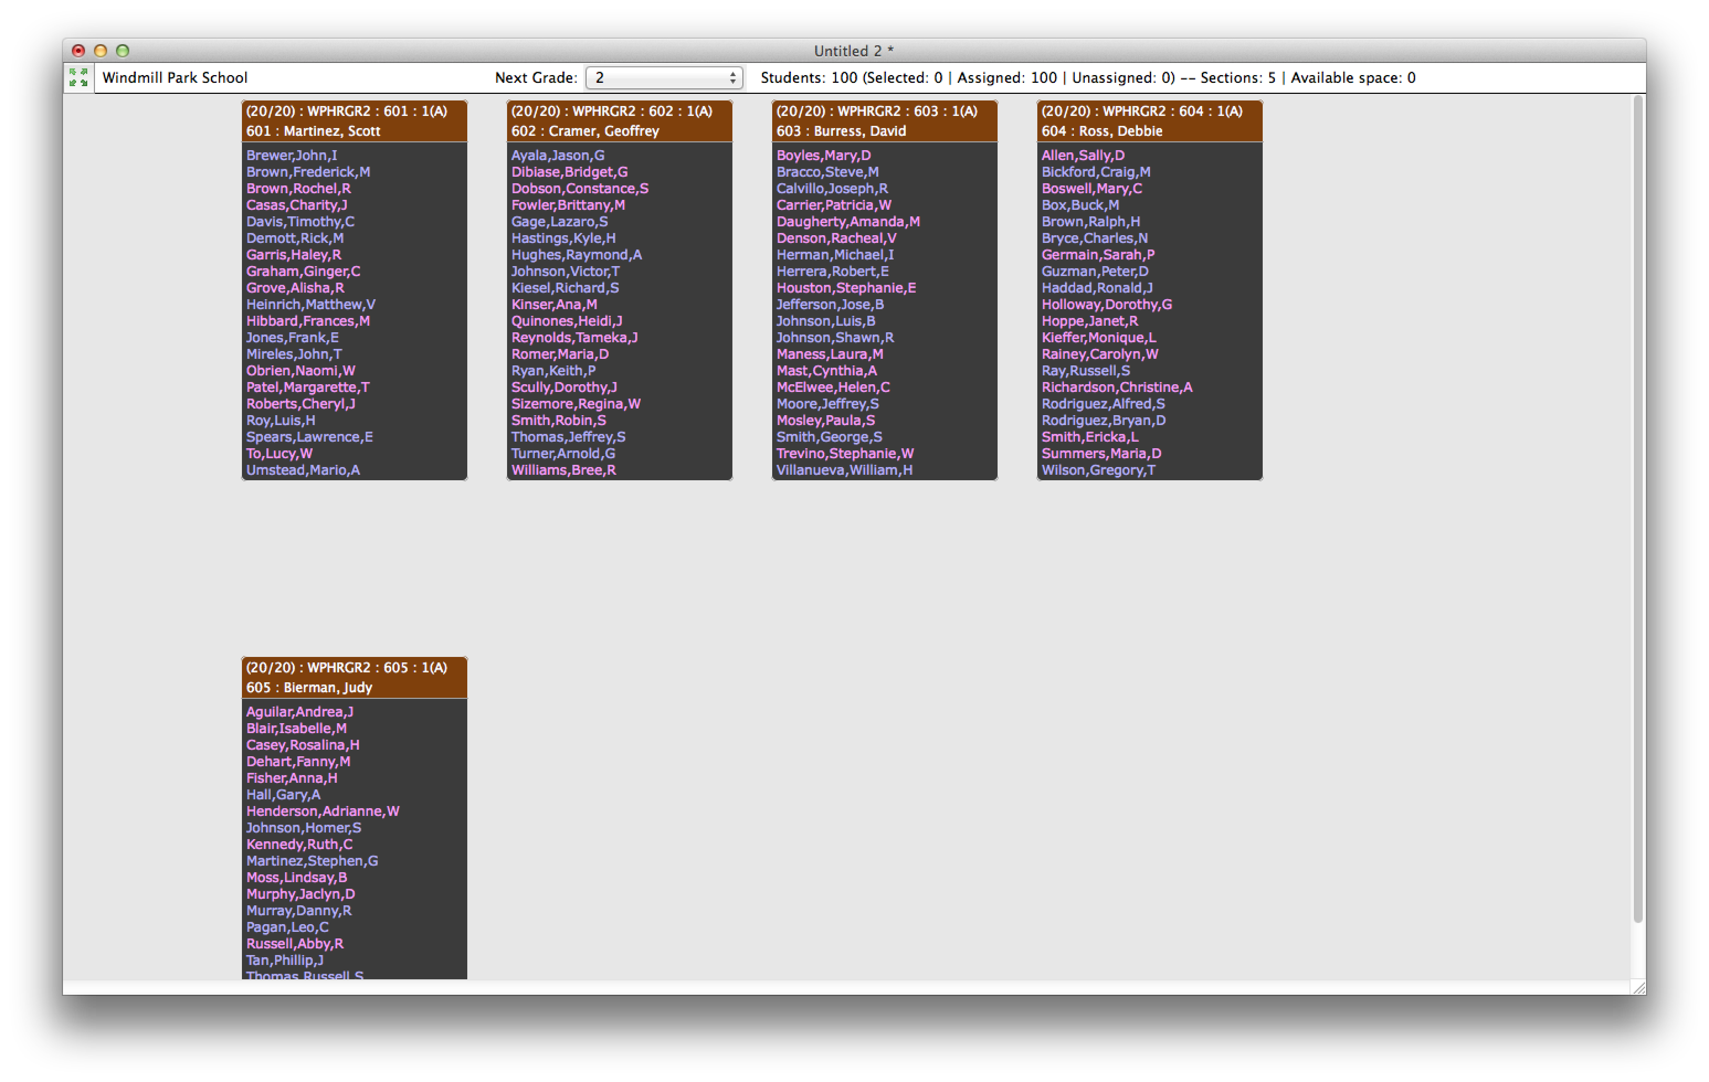
evScheduler
Drag and drop scheduling – Boys and Girls
When you are set- you EXPORT
two text files for:
your schedule
your enrollment

